Slide 1
MVP Global Summit
March 29 – 31, 2022
Learn more at summit.microsoft.com

Slide 2



Microsoft Confidential
Please note, all the content you hear today is considered under NDA unless otherwise stated by the presenters. Please do not blog, tweet, or share any content publicly.
If you have any questions as to whether content can be shared, please ask the presenters. We encourage you to use the meeting chat at any time to ask questions regarding content or to request support.
At the end of the session, don’t forget to respond the survey. We appreciate your feedback as we use this to improve future events.

Slide 3
Inclusive Session Guidelines
Please practice these tips while in Summit Sessions.
Code of Conduct
Audience Guidance
Be welcoming and respectful
Be aware of others
Be open to all questions & viewpoints
Be understanding of differences
Be friendly and patient
Be kind and considerate to others
Use raise hand to ask a question
Questions in chat to be prefaced with Q:
@mention to respond to an individual
Return to mute when not talking
Use alt-text for images and gifs
Immersive reader can be found by clicking on … in the meeting chat
Visit the full Event Code of Conduct or report an issue by visiting aka.ms/SummitCoC
Notes:
Do Not Delete. Do Not Change.

Slide 4
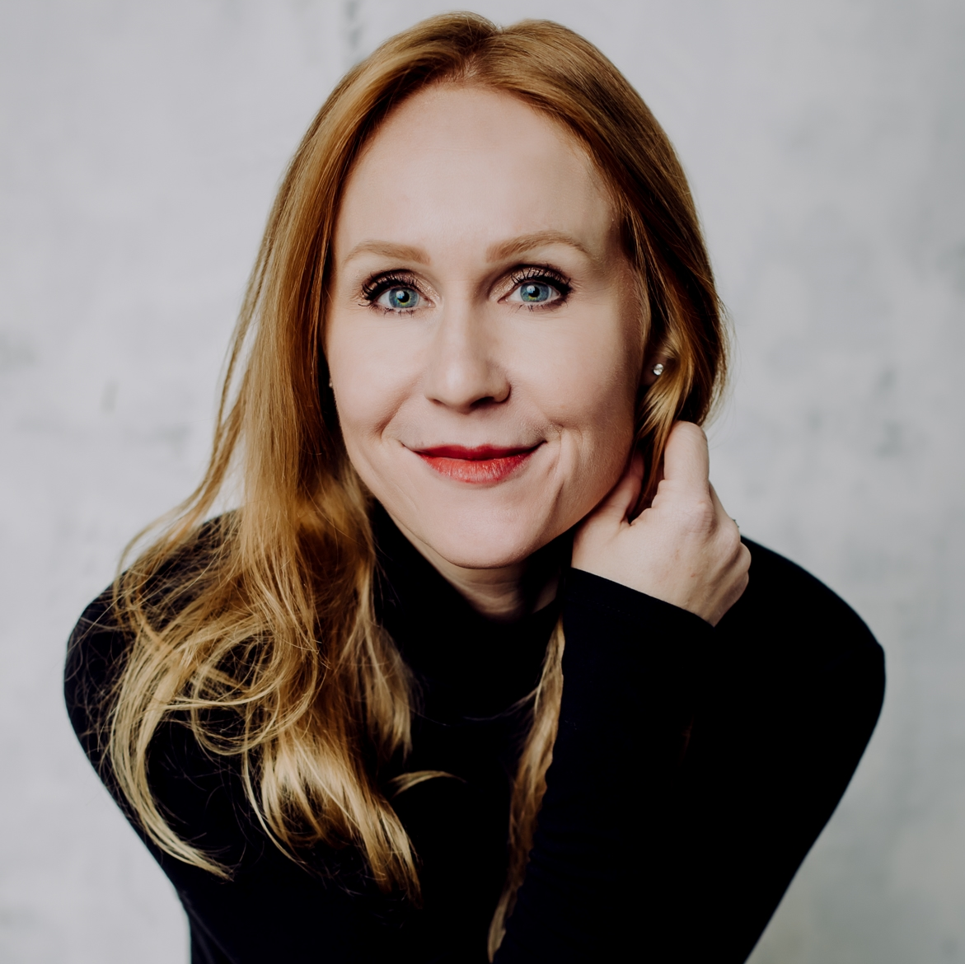
Speaker Bio
Corissa Koopmans
Her/She
Senior Program Manager Identity Network & Access Management
CoKoopma@microsoft.com

Slide 5
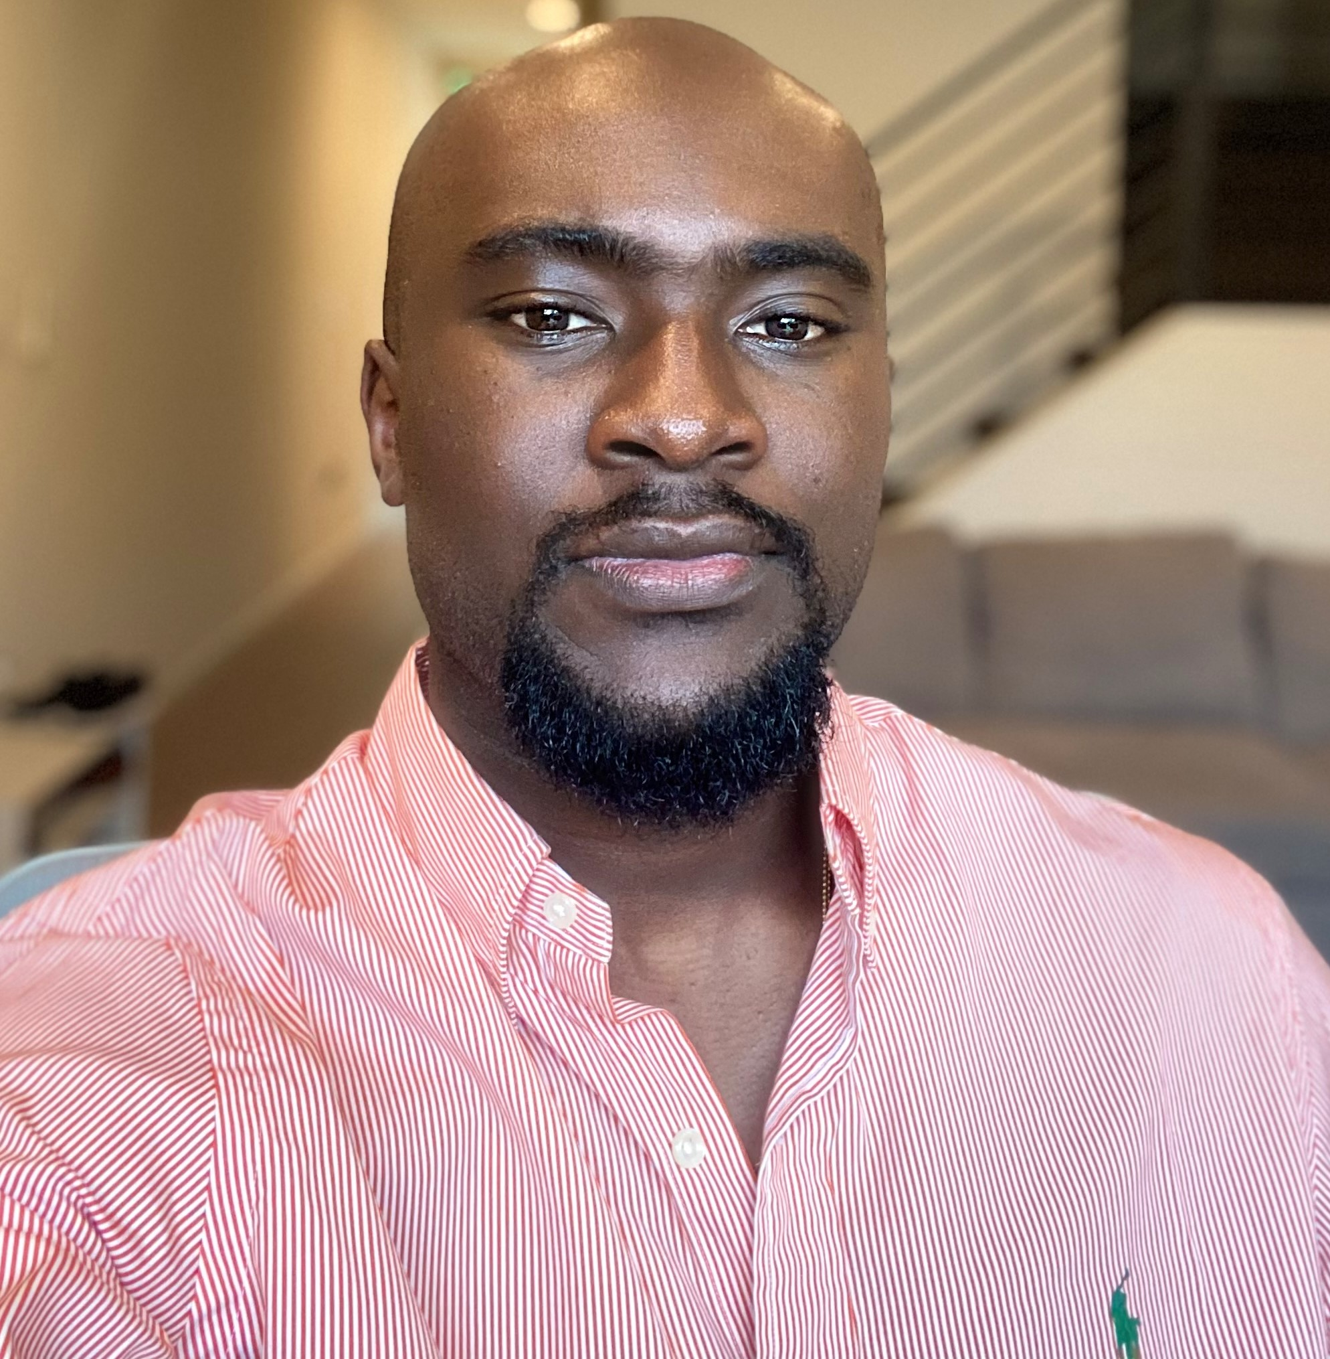
Speaker Bio
Tosin Lufadeju
He/Him
Program Manager Identity Network & Access Management
Tolufade@microsoft.com

Slide 6
Azure AD Workbooks Lessons learned and how you can contribute

Slide 7
Session learning Objective
The objective of this session is to share what we have done, what's new and what we need from you, the MVP Community!
Notes:
Do Not Delete. Do Not Change.

Slide 8
Agenda
Introduction​
Azure AD Workbooks overview
Business use cases and new workbooks
Lessons learned in Log Analytics and KQL
Our ask to the MVP Community
Notes:
Do Not Delete. Do Not Change.

Slide 9
Previous MVP Summit Presentations (aka.ms/KQLMVP)
2020: EM-053 Log Analytics Wizardry (Beginner)
2021: EM-003/004 KQL: From Hero to Superhero (Intermediate)
2022: EM-014 Lesson learned from new Azure AD Workbooks and how you can contribute to them (Intermediate/Advanced)
All resources shared in the presentation can be found at aka.ms/KQLMVP

Slide 10

Access Management goes beyond Identity
Classify, label, encrypt
Data
Identities
Organization policy
Multi-factor authentication
Adaptive access
Apps
User/session risk
Security policy enforcement
Real-time policy evaluation
Device risk state
Access and runtime control
Infrastructure
Device inventory
Devices/ Endpoints
Threat protection
Threat intelligence
Visibility and Analytics
Network
Automation
Notes:
A holistic approach to Zero Trust approach should extend throughout the entire digital estate—
Visibility, Analytics, and Automation: Telemetry from the systems above must be processed and acted on automatically. Attacks happen at cloud speed – your defense systems must act at cloud speed as well, and humans just can’t react quickly enough. Integrate intelligence with policy-based response for real-time automated threat protection.

Slide 11
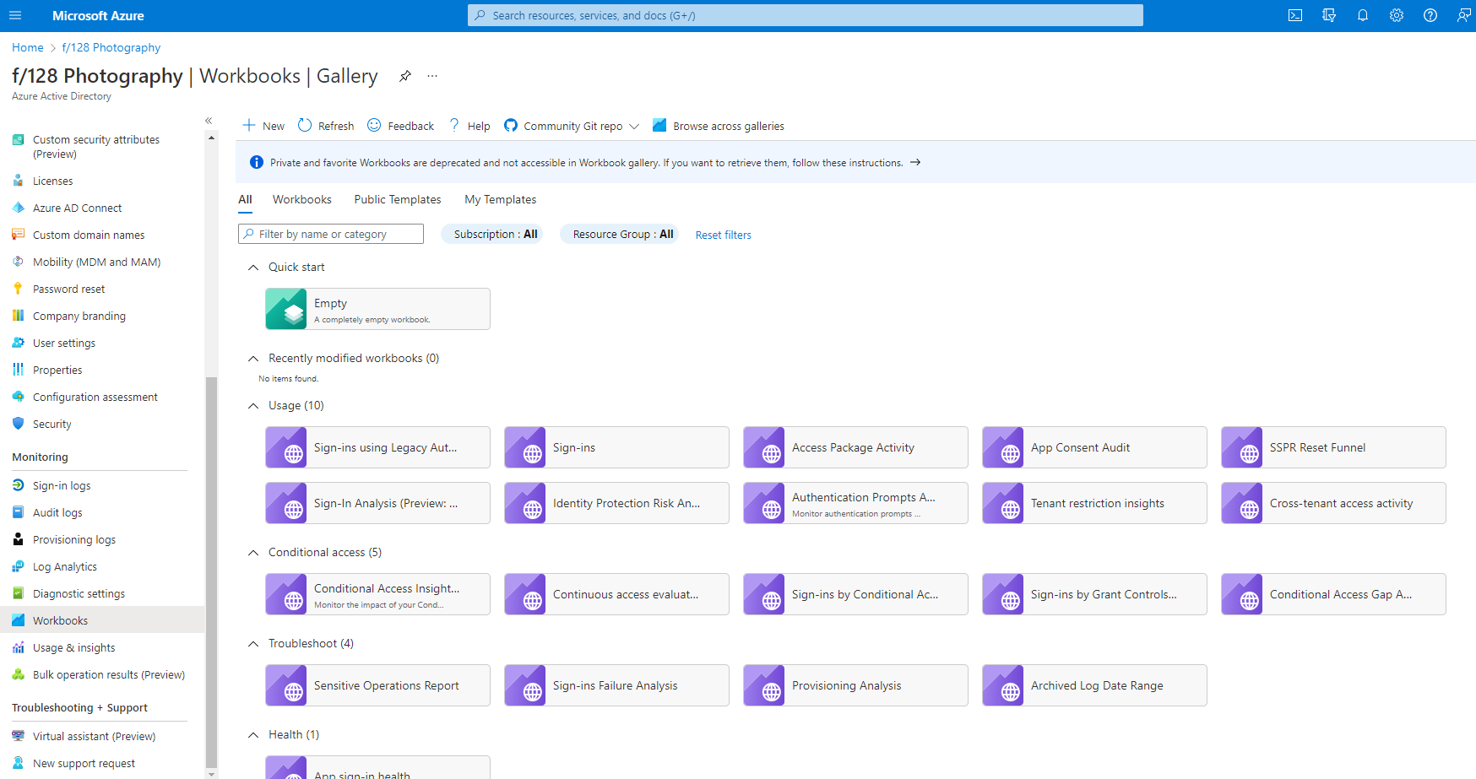
Azure AD Workbooks overview
Create a new workbook.
Discover workbooks with tabs and search.
Open a workbook template; use it as–is or edit it to suit your needs.
Set up data to flow into Log Analytics.
Browse workbook templates in the Azure AD Workbooks gallery.
Notes:
Focus is on workbook but the value you get is just as good as the data that is fed into them.
A prerequisite to having any of these is have a log analytics workspace.
You find that under the monitoring blade of the portal
You can use the reports as is or create a whole new report to fit your needs. You have a range of data sources and logs that get fed into workbooks to create extensive reports

Slide 12
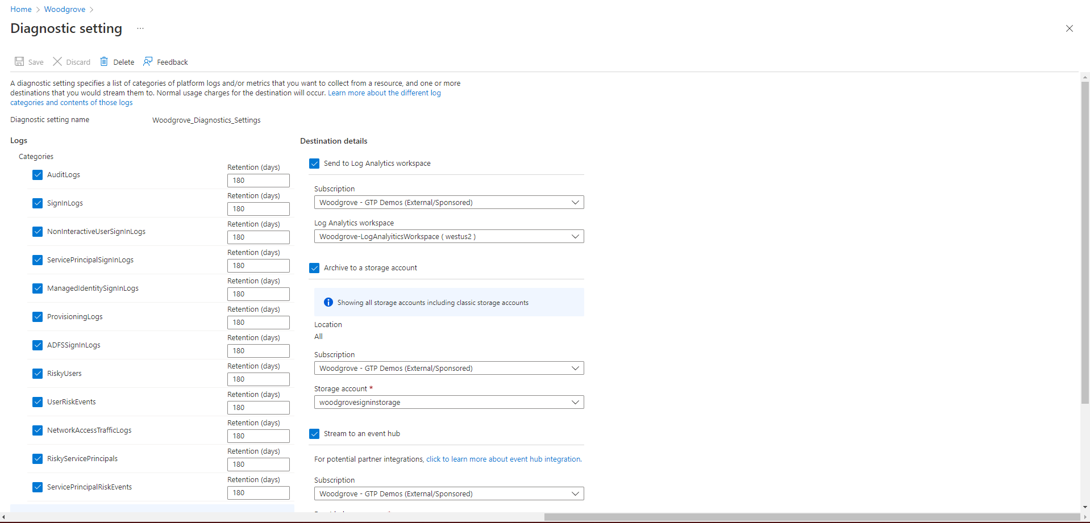
Notes:
In the diagnostics setting blade
This is where you flow the data into workbooks
- select the Categories you care about along with the preferred retention schedule and all the other services you want to feed into
For richer workbooks we recommend a longer retention period to gather enough data points.

Slide 13
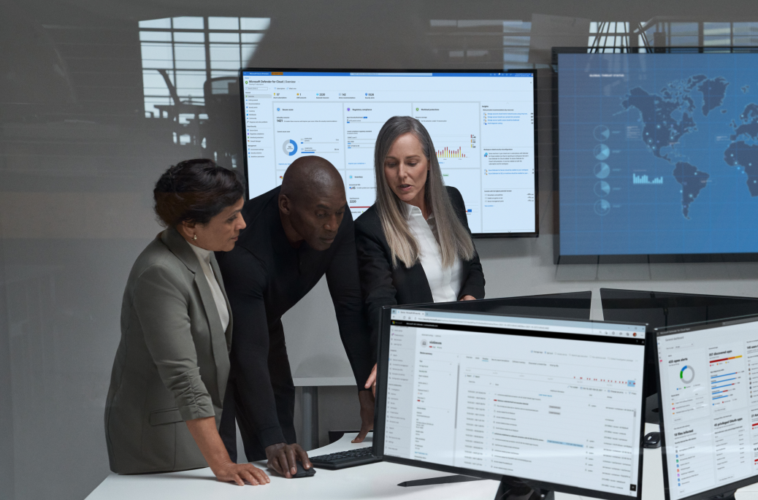
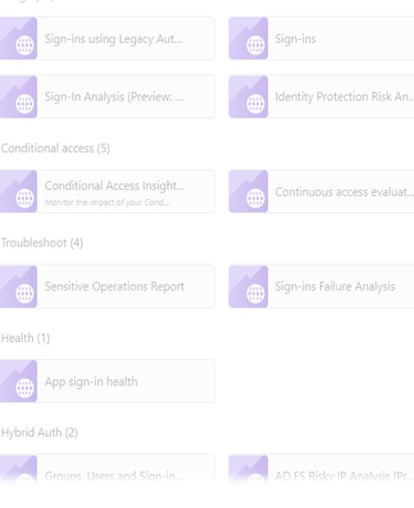
Business Use Cases
Executive complains about too many MFA prompts​
Microsoft announces the deprecation of Legacy TLS​
Transitioning from ADFS to Azure AD Authentication
Customer wants to understand their cross-tenant activity
Notes:
As GTP PMS, we get to interact with some of Microsoft’s biggest customers and get to listen to pain points that gets fed back into the product. Some use cases that emphasize benefits of Workbooks are :
Blocking legacy auth and needing to see who still uses it
Customer who collaborate with other tenants want some insights into how that is being used and how much exposure they have

Slide 14
A look at new Azure AD Workbooks
Notes:
Let’s look at some of the workbooks so you can start making use of these insights

Slide 15
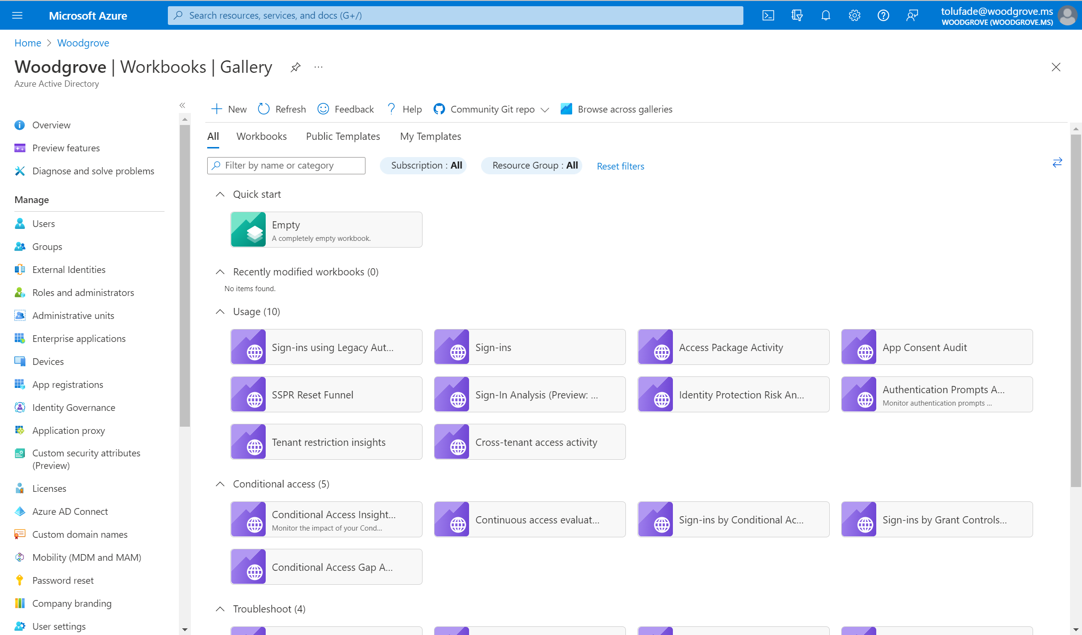
Tip ands Tricks
Notes:
Legacy reports,

Slide 16
Tip ands Tricks
Notes:
Now we are going to dive in a bit more on how to make the most of these workbooks.

Slide 17
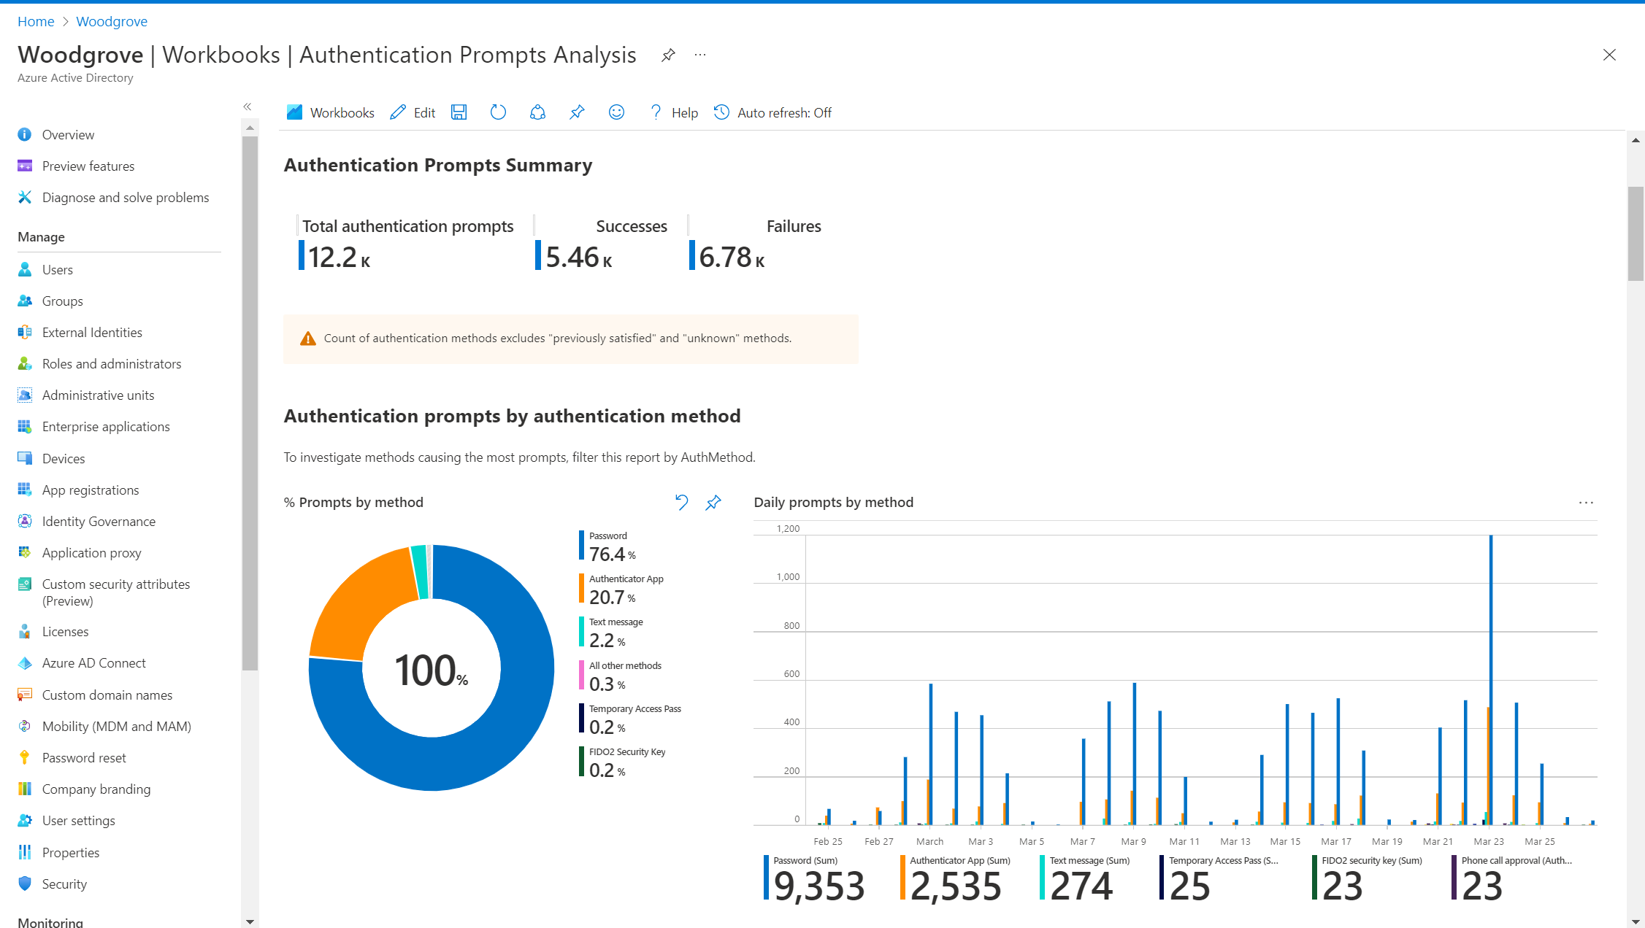
Notes:
I want to see the total number of Prompts over a period of time and what proportion of those were successful vs failures.

Slide 18
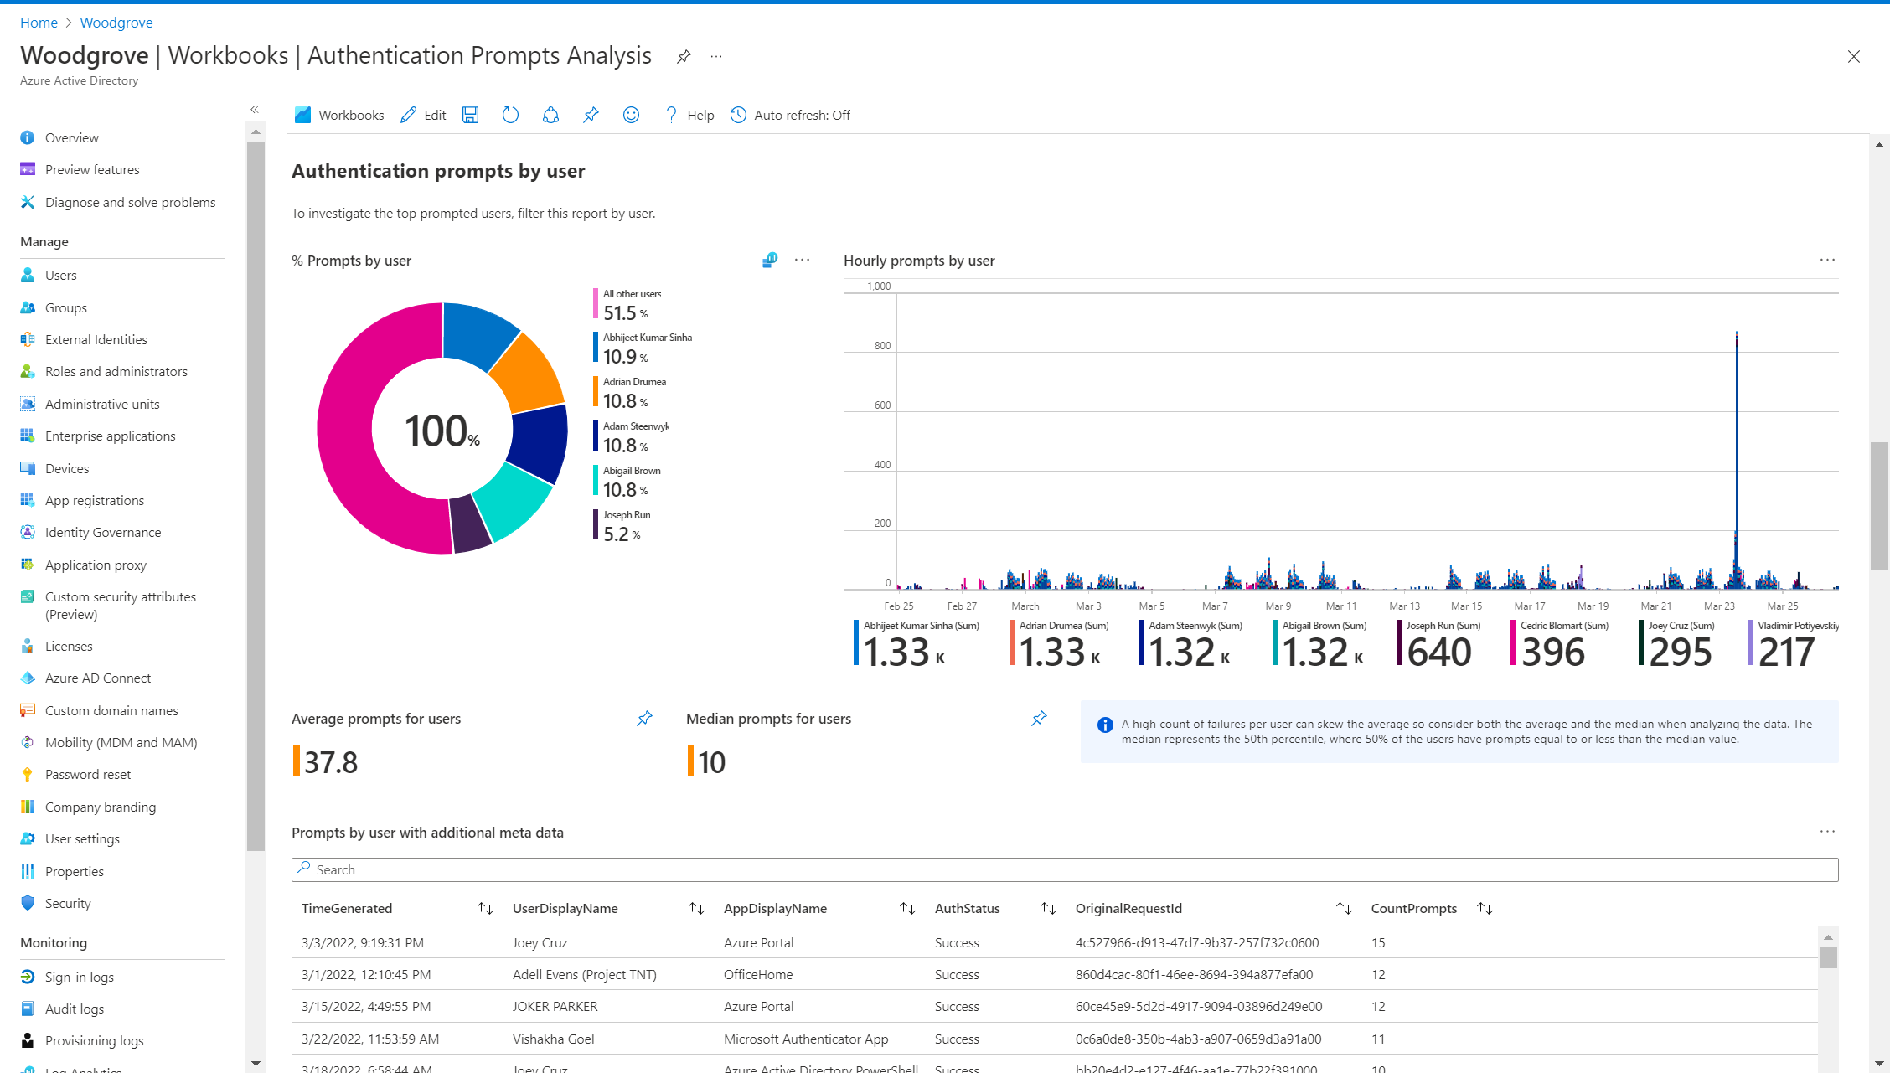
Notes:
Whats the average acceptable number and are certain users truly way above
Need to investigate
With the blue icon you can view the actual query in Log analytics

Slide 19
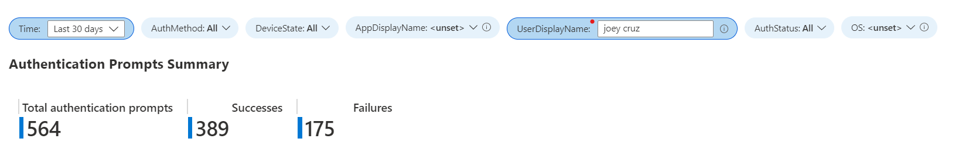
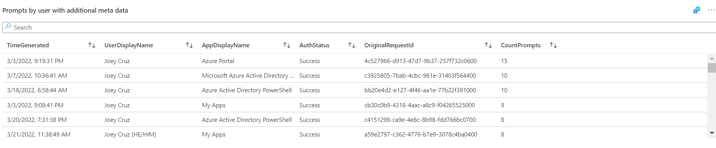
Notes:
Filter allows you to focus on one user and look through all datapoints specific to that user.

Slide 20
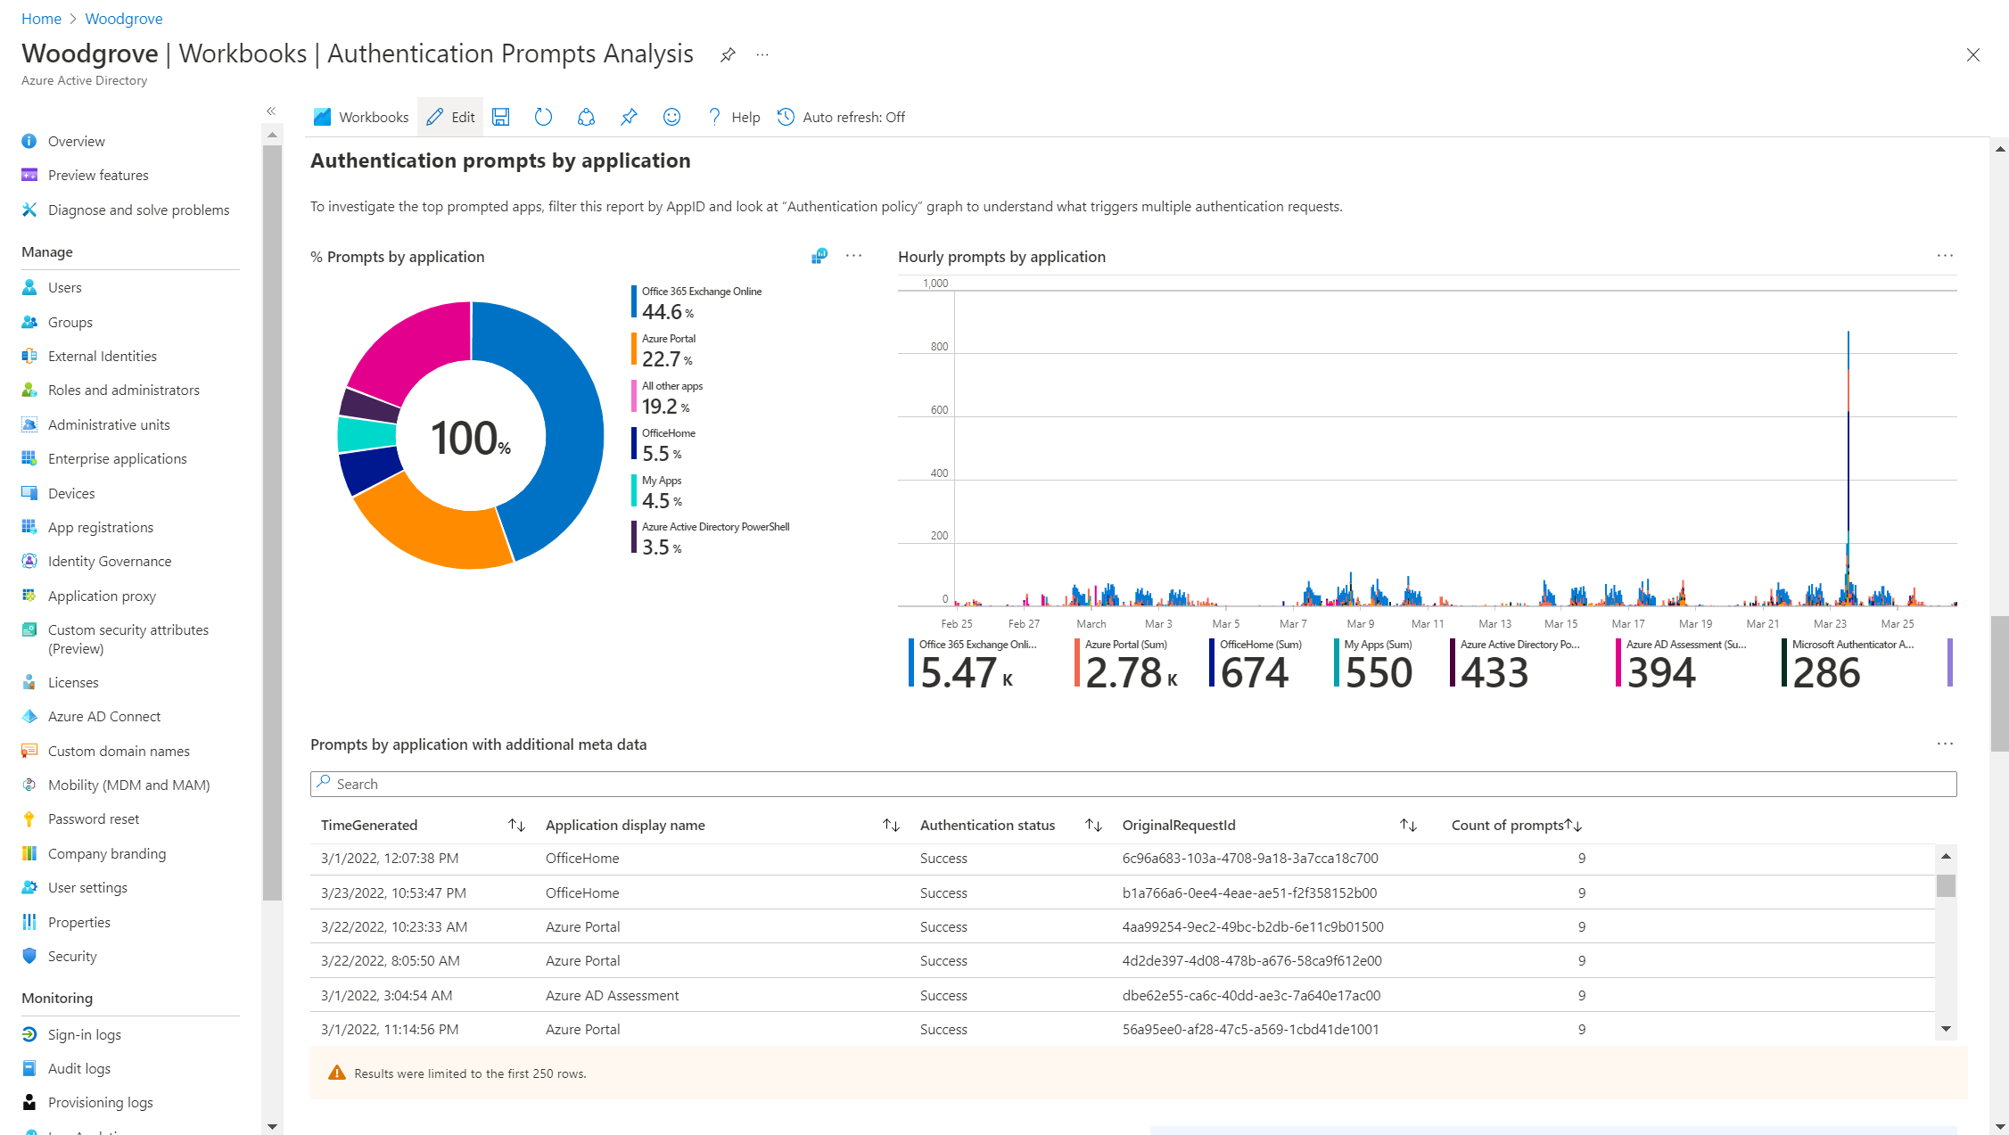
Notes:
When building you can add prompts and messages, so the readers get some extra message you are trying to convey.

Slide 21
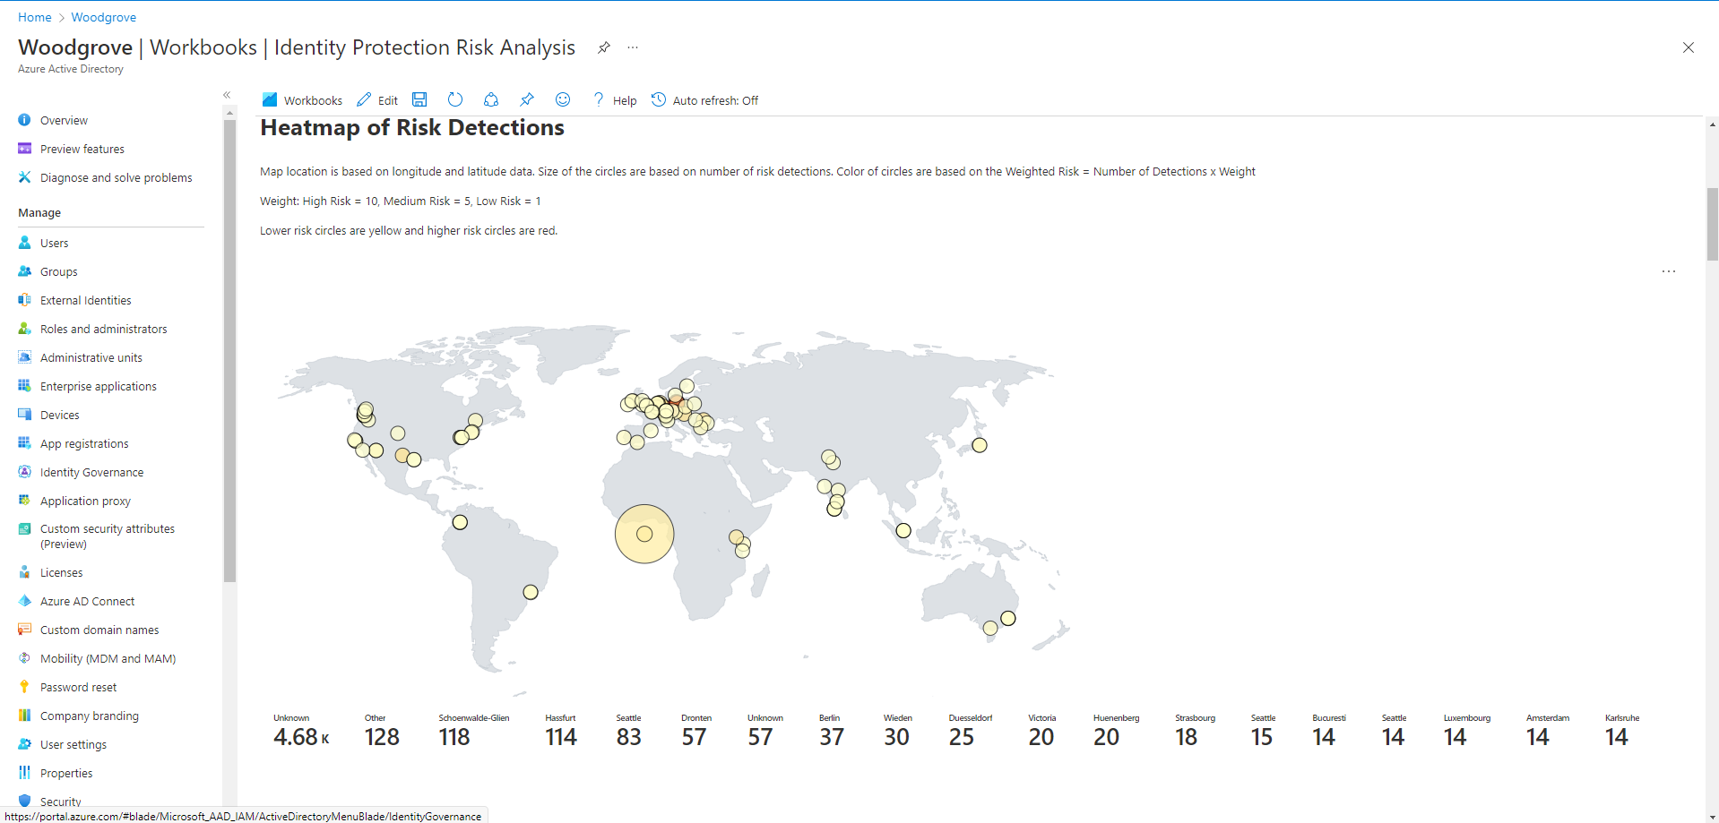

Notes:
With Identity Protection configured, customers want to have a quick view into where their risk events are coming from
Quick way to see those
Read means high, Yellow low
Circle size indicates higher count

Slide 22
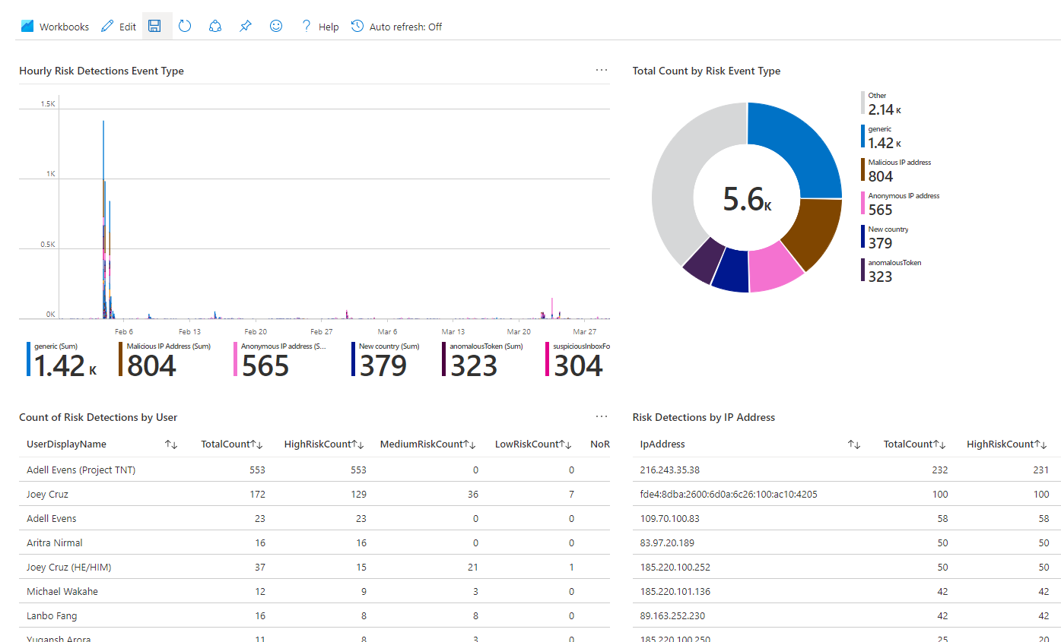
Notes:
In this report you can have it broken down into risk event type.
Can give some insights into the type of attacks you experience frequently and can guide your decision to take proactive measures

Slide 23
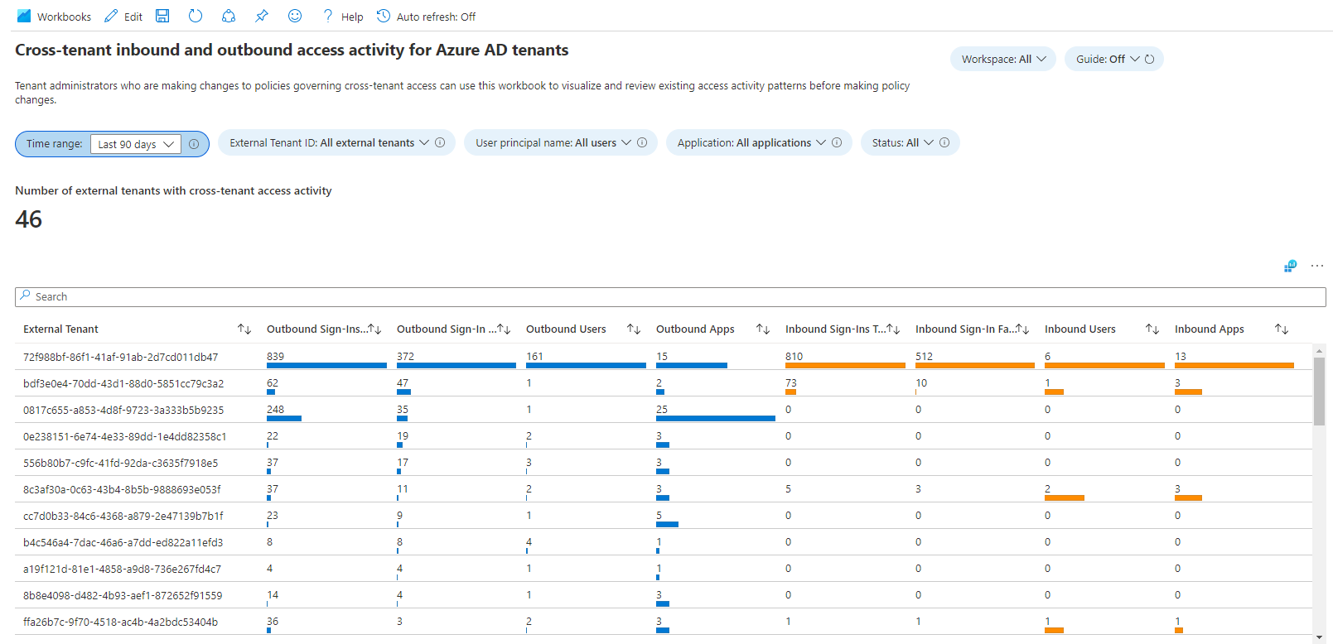
Notes:
Cross tenant access was enabled to increase collaboration with partners.
How many other tenants do I have cross tenant activity with?
Who are my users interacting with?
What proportion are outbound vs inbound sign ins?
Are these connections still necessary?
You can click on tenant to focus on that subset.

Slide 24
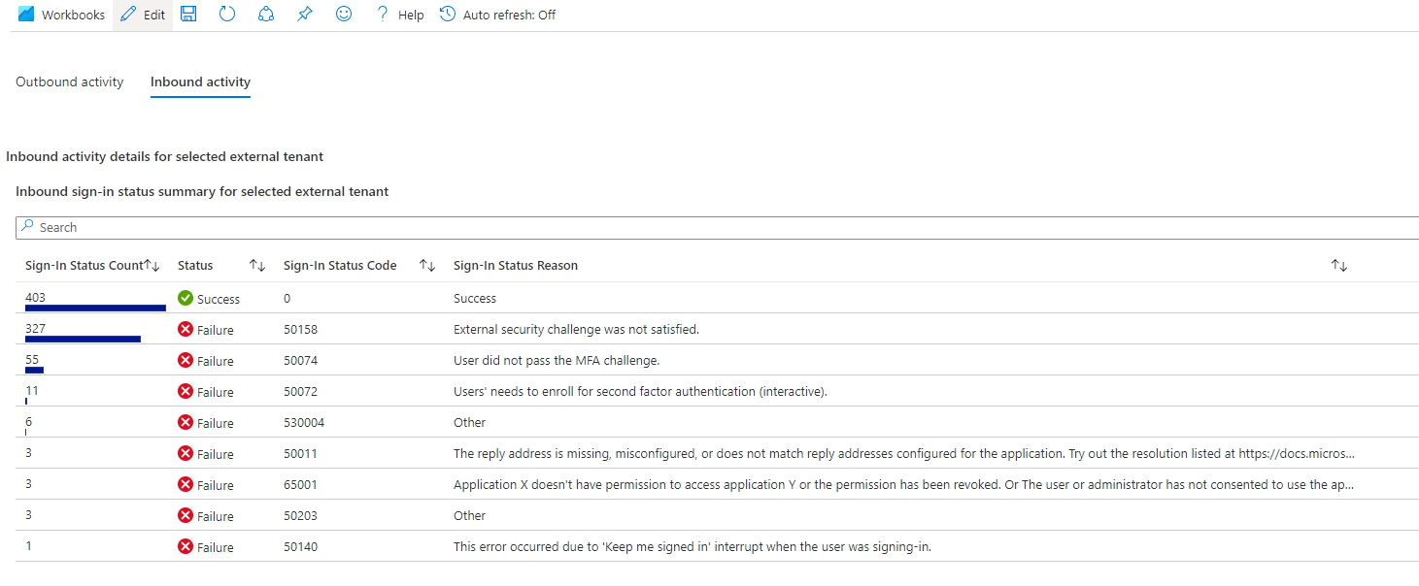
Notes:
When troubleshooting sign in issues, its valuable to see the error categorized into reasons
Could possibly reduce support cases if the reason is understood.
Is there a need for user education etc

Slide 25
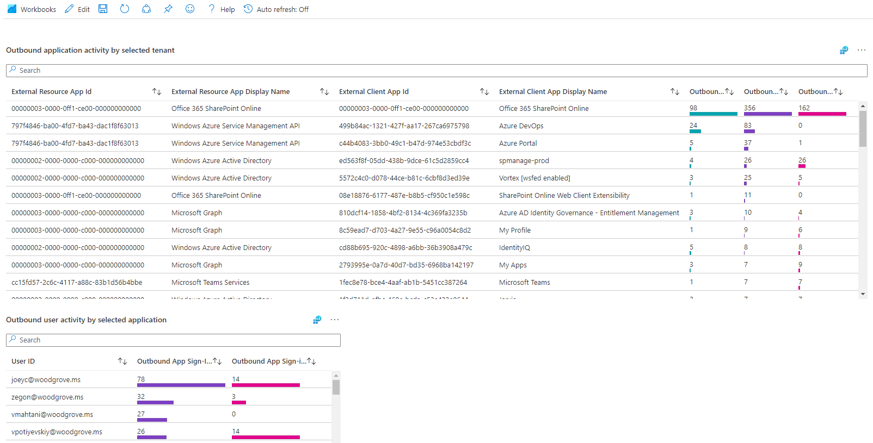
Notes:
With the outbound activity report you can see what applications on the other tenant your users are interacting with.
It gives data driven insights that you can take necessary action on.

Slide 26
Lessons learned​ in Log Analytics and KQL
Notes:
Now we are going to dive in a bit more on how to make the most of these workbooks.

Slide 27
Percentages

Slide 28
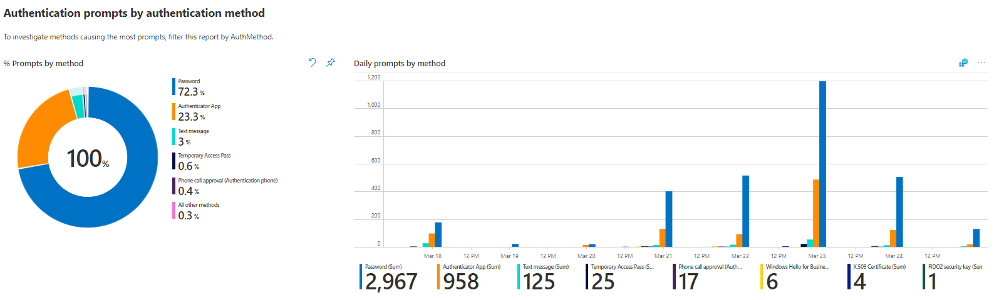
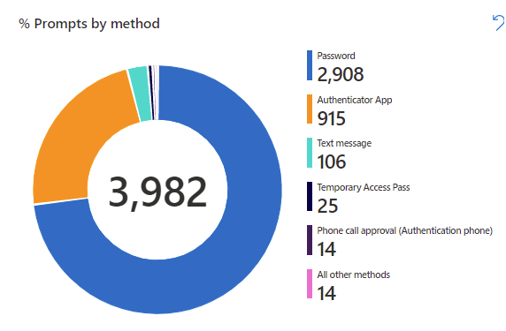
Laying out your workbook

Slide 29
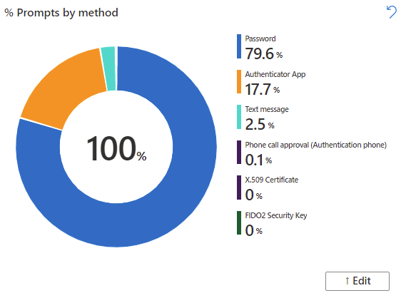
Converting count to percentages

Slide 30
Base query
SigninLogs
|mv-expand ParsedFields=parse_json(AuthenticationDetails) //parse out Authentication Details column and put in new column called “ParsedFields”
|extend AuthenticationMethod = ParsedFields.authenticationMethod //create new column by extracting the authenticationMethod value out of the ParsedFields column
|extend AuthMethod = tostring(AuthenticationMethod) //convert to string format
|extend ParsedFields2=parse_json(DeviceDetail) //parse out Device Details column and put in column called “ParsedFields2”
|extend DeviceState = case(DeviceDetail["trustType"] == "", "Unmanaged", DeviceDetail["trustType"]) //convert to string
|extend OperatingSystem = ParsedFields2.operatingSystem //extract the operatingSystem value out of the ParsedFields2 column
|extend OS = tostring(OperatingSystem) //convert to string format
|where AuthMethod != "Previously satisfied" and AuthMethod != "“ //remove Previously Satisfied and blank AuthMethods from the query
|where UserDisplayName != "On-Premises Directory Synchronization Service Account“ //remove this UserDisplayDname
|where AuthMethod in ({AuthMethod}) or '*' in ({AuthMethod}) //AuthMethod parameter
|where DeviceState in ({DeviceState}) or '*' in ({DeviceState}) //DeviceState parameter
|where "{User:escape}" == "All users" or UserDisplayName contains "{User:escape}“ //User parameter
|where "{App:escape}" == "All apps" or AppDisplayName contains "{App:escape}“ //App parameter
|where "{OS:escape}" == "All OS" or OS contains "{OS:escape}“ //OS parameter
|extend Status = ParsedFields.succeeded //extract the succeeded valueout of the ParsedFields2 column
|extend AuthStatus = case(Status == "true", "Success", "Failure") //label status as Success or Failure
|where AuthStatus in ({AuthStatus}) or '*' in ({AuthStatus}) //AuthStatus parameter
|summarize Count = count() by AuthMethod //summarize operator aggregates data and produces count by AuthMethod

Slide 31
Percentage
let baseQuery = //store a dataset in baseQuery
materialize(SigninLogs //materialize creates a subquery that other queries can reference
|mv-expand ParsedFields=parse_json(AuthenticationDetails) //parse out Authentication Details column and put in new column called “ParsedFields”
|extend AuthenticationMethod = ParsedFields.authenticationMethod //create new column by extracting the authenticationMethod value out of the ParsedFields column
|extend AuthMethod = tostring(AuthenticationMethod) //convert to string format
|extend ParsedFields2=parse_json(DeviceDetail) //parse out Device Details column and put in column called “ParsedFields2”
|extend DeviceState = case(DeviceDetail["trustType"] == "", "Unmanaged", DeviceDetail["trustType"]) //convert to string
|extend OperatingSystem = ParsedFields2.operatingSystem //extract the operatingSystem value out of the ParsedFields2 column
|extend OS = tostring(OperatingSystem) //convert to string format
|where AuthMethod != "Previously satisfied" and AuthMethod != "“ //remove Previously Satisfied and blank AuthMethods from the query
|where UserDisplayName != "On-Premises Directory Synchronization Service Account“ //remove this UserDisplayDname
|where AuthMethod in ({AuthMethod}) or '*' in ({AuthMethod}) //AuthMethod parameter
|where DeviceState in ({DeviceState}) or '*' in ({DeviceState}) //DeviceState parameter
|where "{User:escape}" == "All users" or UserDisplayName contains "{User:escape}“ //User parameter
|where "{App:escape}" == "All apps" or AppDisplayName contains "{App:escape}“ //App parameter
|where "{OS:escape}" == "All OS" or OS contains "{OS:escape}“ //OS parameter
|extend Status = ParsedFields.succeeded //extract the succeeded valueout of the ParsedFields2 column
|extend AuthStatus = case(Status == "true", "Success", "Failure") //label status as Success or Failure
|where AuthStatus in ({AuthStatus}) or '*' in ({AuthStatus}) //AuthStatus parameter
);
let totalCount = toscalar(baseQuery | count); //return a scalar constant value of the evaluated expression
baseQuery //reference the baseQuery
|summarize Count = count(AuthMethod) * 100.0 /totalCount by AuthMethod //aggregate count, divide by total count

Slide 32
Converting count to percentages

Slide 33
Interactive Graphs

Slide 34
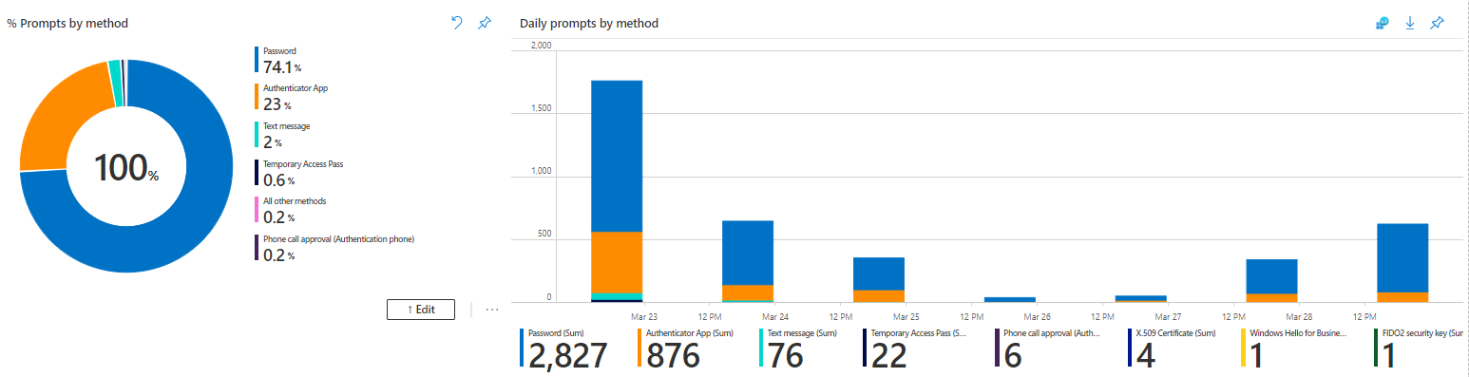
Interactive Graphs

Slide 35
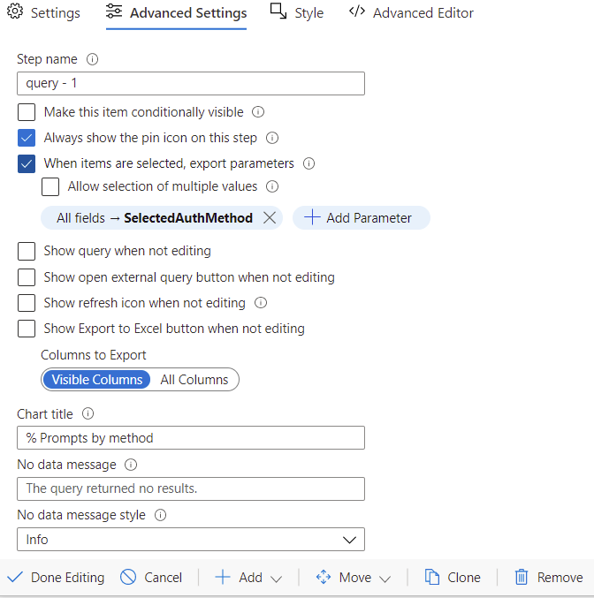
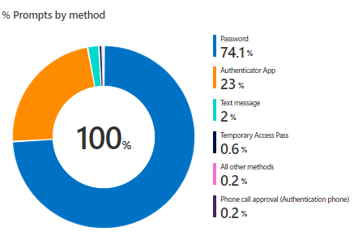
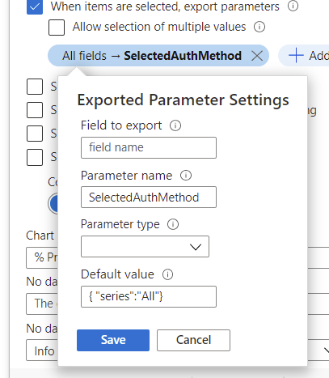
Interactive graphs

Slide 36
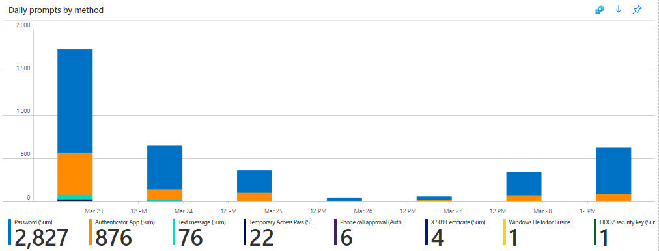
Interactive graphs
|mv-expand ParsedMethod = parse_json(tostring('{SelectedAuthMethod}'))
|extend SelectedAuthMethod = ParsedMethod.series
|where SelectedAuthMethod == 'All' or (AuthMethod == SelectedAuthMethod)

Slide 37
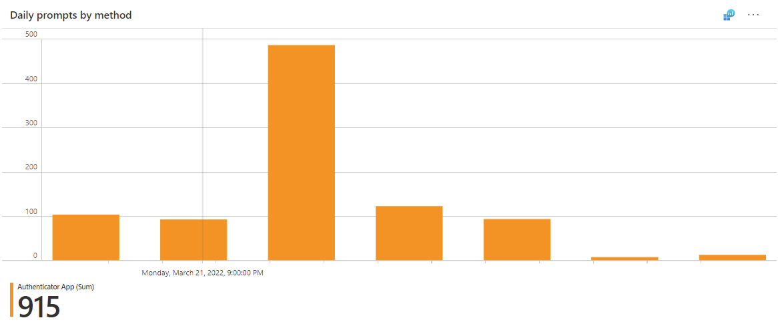
Interactive graphs
SigninLogs
|mv-expand ParsedFields=parse_json(AuthenticationDetails) //parse out Authentication Details column and put in new column called “ParsedFields”
|extend AuthenticationMethod = ParsedFields.authenticationMethod //create new column by extracting the authenticationMethod value out of the ParsedFields column
|extend AuthMethod = tostring(AuthenticationMethod) //convert to string format
|mv-expand ParsedMethod = parse_json(tostring('{SelectedAuthMethod}’)) //parse out SelectedAuthMethod
|extend SelectedAuthMethod = ParsedMethod.series //create new column with by extracting series value
|where SelectedAuthMethod == 'All' or (AuthMethod == SelectedAuthMethod) //parameters for SelectedAuthMethod
|extend ParsedFields2=parse_json(DeviceDetail) //parse out Device Details column and put in column called “ParsedFields2”
|extend DeviceState = case(DeviceDetail["trustType"] == "", "Unmanaged", DeviceDetail["trustType"]) //convert to string
|extend OperatingSystem = ParsedFields2.operatingSystem //extract the operatingSystem value out of the ParsedFields2 column
|extend OS = tostring(OperatingSystem) //convert to string format
|where AuthMethod != "Previously satisfied" and AuthMethod != "“ //remove Previously Satisfied and blank AuthMethods from the query
|where UserDisplayName != "On-Premises Directory Synchronization Service Account“ //remove this UserDisplayDname
|where AuthMethod in ({AuthMethod}) or '*' in ({AuthMethod}) //AuthMethod parameter
|where DeviceState in ({DeviceState}) or '*' in ({DeviceState}) //DeviceState parameter
|where "{User:escape}" == "All users" or UserDisplayName contains "{User:escape}“ //User parameter
|where "{App:escape}" == "All apps" or AppDisplayName contains "{App:escape}“ //App parameter
|where "{OS:escape}" == "All OS" or OS contains "{OS:escape}“ //OS parameter
|extend Status = ParsedFields.succeeded //extract the succeeded valueout of the ParsedFields2 column
|extend AuthStatus = case(Status == "true", "Success", "Failure") //label status as Success or Failure
|where AuthStatus in ({AuthStatus}) or '*' in ({AuthStatus}) //AuthStatus parameter
|summarize AuthMethCount = count() by bin (TimeGenerated, 1d), AuthMethod //aggregate to count the daily sum
By AuthMethod

Slide 38
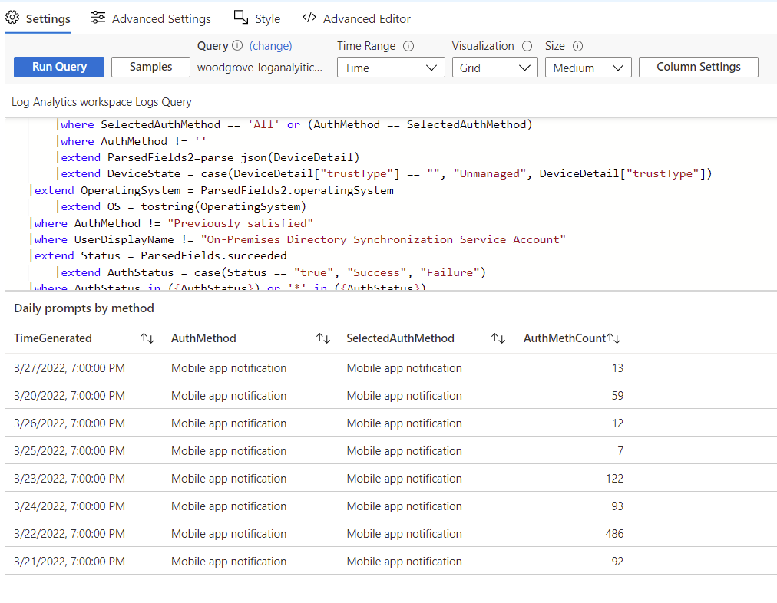
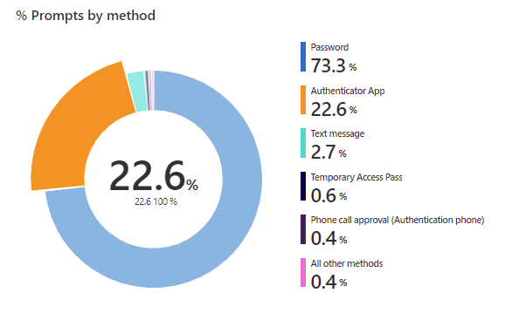
Interactive Graphs

Slide 39
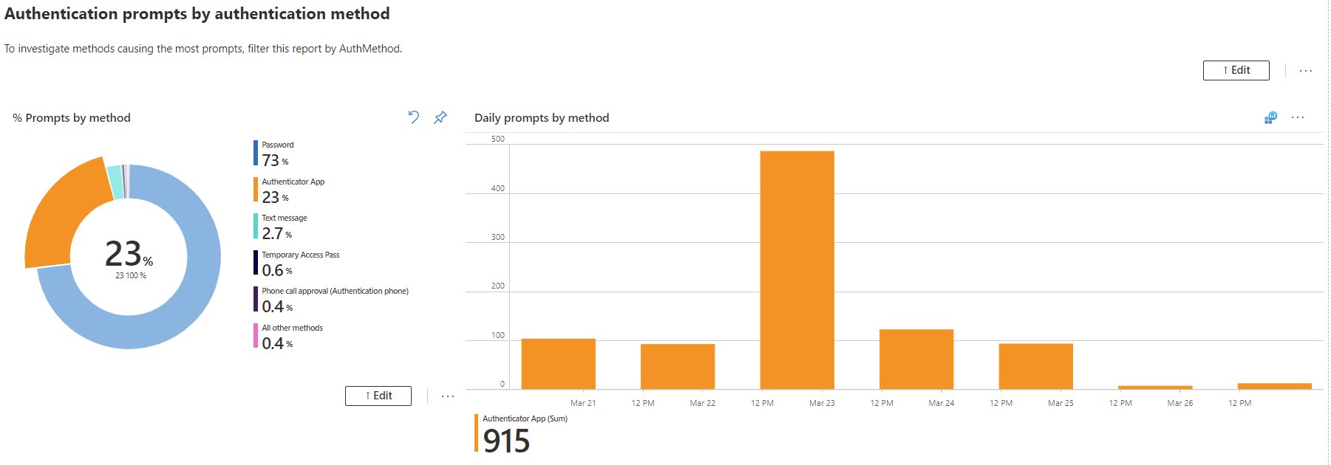
Interactive Graphs

Slide 40
Union

Slide 41
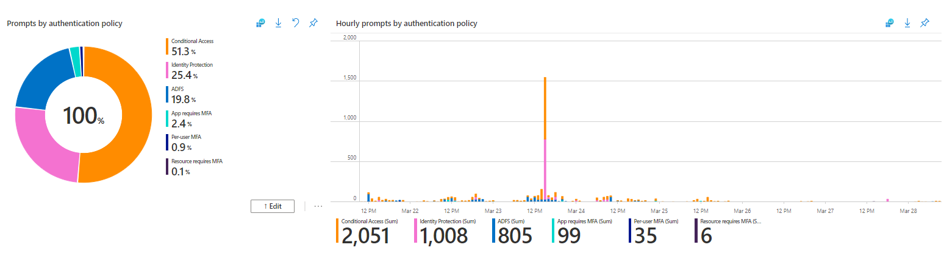
Union of two data sets

Slide 42
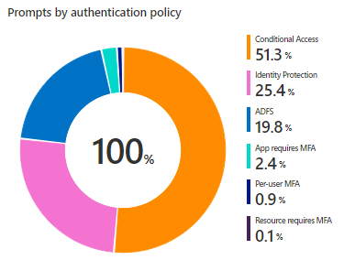
Union of two data sets: the pie chart
let policyData = SigninLogs
|mv-expand ParsedFields=parse_json(AuthenticationDetails)
|extend AuthenticationMethod = ParsedFields.authenticationMethod
|extend AuthMethod = tostring(AuthenticationMethod)
|extend ParsedFields2=parse_json(DeviceDetail)
|extend DeviceState = case(DeviceDetail["trustType"] == "", "Unmanaged", DeviceDetail["trustType"])
|extend OperatingSystem = ParsedFields2.operatingSystem
|extend OS = tostring(OperatingSystem)
|mv-expand ParsedFields3 = parse_json(AuthenticationRequirementPolicies)
|extend AuthReqPolicy = ParsedFields3.detail
|extend AuthPolicy = tostring(AuthReqPolicy)
|where AuthMethod != "Previously satisfied" and AuthMethod != ""
|where UserDisplayName != "On-Premises Directory Synchronization Service Account"
|where AuthMethod in ({AuthMethod}) or '*' in ({AuthMethod})
|where DeviceState in ({DeviceState}) or '*' in ({DeviceState})
|where "{User:escape}" == "All users" or UserDisplayName contains "{User:escape}"
|where "{App:escape}" == "All apps" or AppDisplayName contains "{App:escape}"
|where "{OS:escape}" == "All OS" or OS contains "{OS:escape}"
|extend Status = ParsedFields.succeeded
|extend AuthStatus = case(Status == "true", "Success", "Failure")
|where AuthStatus in ({AuthStatus}) or '*' in ({AuthStatus})
|project AuthPolicy, UserDisplayName, AppDisplayName;
let adfsData = ADFSSignInLogs
|mv-expand PF=parse_json(AuthenticationDetails)
|extend AuthDetail = PF.authenticationMethodDetail
|extend AuthPolicy = tostring(AuthDetail)
|where UserDisplayName != "On-Premises Directory Synchronization Service Account"
|where "{User:escape}" == "All users" or UserDisplayName contains "{User:escape}"
|where "{App:escape}" == "All apps" or AppDisplayName contains "{App:escape}"
|extend Status = PF.succeeded
|extend AuthStatus = case(Status == "true", "Success", "Failure")
|where AuthStatus in ({AuthStatus}) or '*' in ({AuthStatus})
|project AuthPolicy, AuthStatus, AppDisplayName, UserDisplayName;
let basequery = materialize(
union policyData, adfsData
|summarize totalCount = count() by AuthPolicy
);
let total = toscalar(
basequery
| summarize sum(totalCount)
);
basequery
| extend pct = totalCount*100.0/total
Notes:
It’s a lot so let’s break it down into 3 parts

Slide 43
Break it down: First part of the query
let policyData = SigninLogs
|mv-expand ParsedFields=parse_json(AuthenticationDetails) //parse out Authentication Details column and put in new column called “ParsedFields”
|extend AuthenticationMethod = ParsedFields.authenticationMethod //create new column by extracting the authenticationMethod value out of the ParsedFields column
|extend AuthMethod = tostring(AuthenticationMethod) //convert to string format
|extend ParsedFields2=parse_json(DeviceDetail) //parse out Device Details column and put in column called “ParsedFields2”
|extend DeviceState = case(DeviceDetail["trustType"] == "", "Unmanaged", DeviceDetail["trustType"]) //convert to string
|extend OperatingSystem = ParsedFields2.operatingSystem //extract the operatingSystem value out of the ParsedFields2 column
|extend OS = tostring(OperatingSystem) //convert to string format
|mv-expand ParsedFields3 = parse_json(AuthenticationRequirementPolicies)
|extend AuthReqPolicy = ParsedFields3.detail
|extend AuthPolicy = tostring(AuthReqPolicy)
|where AuthMethod != "Previously satisfied" and AuthMethod != "“ //remove Previously Satisfied and blank AuthMethods from the query
|where UserDisplayName != "On-Premises Directory Synchronization Service Account“ //remove this UserDisplayDname
|where AuthMethod in ({AuthMethod}) or '*' in ({AuthMethod}) //AuthMethod parameter
|where DeviceState in ({DeviceState}) or '*' in ({DeviceState}) //DeviceState parameter
|where "{User:escape}" == "All users" or UserDisplayName contains "{User:escape}“ //User parameter
|where "{App:escape}" == "All apps" or AppDisplayName contains "{App:escape}“ //App parameter
|where "{OS:escape}" == "All OS" or OS contains "{OS:escape}“ //OS parameter
|extend Status = ParsedFields.succeeded //extract the succeeded valueout of the ParsedFields2 column
|extend AuthStatus = case(Status == "true", "Success", "Failure") //label status as Success or Failure
|where AuthStatus in ({AuthStatus}) or '*' in ({AuthStatus}) //AuthStatus parameter
|project TimeGenerated, AuthPolicy, UserDisplayName, AppDisplayName; //Select columns
Notes:
Policy data is now basically a table of the TimeGen, Auth Policy, User Display Name and App Display Name
The Project Operator -Select the columns to include, rename or drop, and insert new computed columns.
The order of the columns in the result is specified by the order of the arguments. Only the columns specified in the arguments are included in the result. Any other columns in the input are dropped. See also extend.

Slide 44
Break it down: Second part of the query
let adfsData = ADFSSignInLogs //store a dataset in adfsData
|mv-expand PF=parse_json(AuthenticationDetails) //parse out AuthenticationDetails column and put in new column called “PF”
|extend AuthDetail = PF.authenticationMethodDetail //create new column by extracting the authenticationMethodDetail value out of the PF column
|extend AuthPolicy = tostring(AuthDetail) //convert to string format
|where UserDisplayName != "On-Premises Directory Synchronization Service Account"
|where "{User:escape}" == "All users" or UserDisplayName contains "{User:escape}“ //User parameter
|where "{App:escape}" == "All apps" or AppDisplayName contains "{App:escape}“ //App parameter
|extend Status = PF.succeeded //extract status from the succeeded value in the PF column
|extend AuthStatus = case(Status == "true", "Success", "Failure") // if true, return “Success”, if not, return Failure
|where AuthStatus in ({AuthStatus}) or '*' in ({AuthStatus}) //AuthStatus parameter
|project TimeGenerated,AuthPolicy, AuthStatus, AppDisplayName, UserDisplayName; //Select columns
Notes:
Now we are going to pull in the ADFS Data itself is a type of policy that we want to observe in this visualization
Not all the same parameters can apply
Case = Evaluates a list of predicates and returns the first result expression whose predicate is satisfied.
If neither of the predicates return true, the result of the last expression (the else) is returned. All odd arguments (count starts at 1) must be expressions that evaluate to a boolean value. All even arguments (the thens) and the last argument (the else) must be of the same type.
range Size from 1 to 15 step 2 | extend bucket = case(Size <= 3, "Small", Size <= 10, "Medium", "Large")

Slide 45
Break it down: Third part of the query
let baseQuery = materialize( //store a dataset in baseQuery
union policyData, adfsData //bring together the first and second query
|summarize totalCount = count() by AuthPolicy); //aggregate count by Auth Policy and close the let statement
let total = //calculate total of baseQuery
toscalar(baseQuery //toscalar will return a constant value of the evaluated expression
| summarize sum(totalCount)); //the evaluated expression totalCount by Auth Policy and close the let statement
baseQuery
| extend pct = totalCount*100.0/total //create new column showing percentage of totalCount
Notes:
Now we are going to pull in the ADFS Data itself is a type of policy that we want to observe in this visualization
Not all the same parameters can apply
Case = Evaluates a list of predicates and returns the first result expression whose predicate is satisfied.
If neither of the predicates return true, the result of the last expression (the else) is returned. All odd arguments (count starts at 1) must be expressions that evaluate to a boolean value. All even arguments (the thens) and the last argument (the else) must be of the same type.
range Size from 1 to 15 step 2 | extend bucket = case(Size <= 3, "Small", Size <= 10, "Medium", "Large")

Slide 46
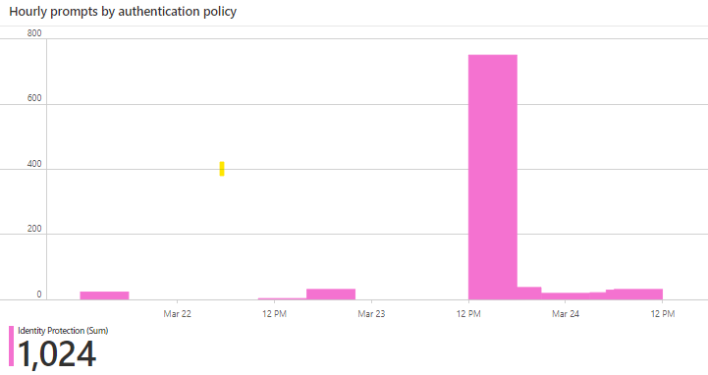
Union of two data sets: the bar chart
let policyData = SigninLogs
|mv-expand ParsedFields=parse_json(AuthenticationDetails)
|extend AuthenticationMethod = ParsedFields.authenticationMethod
|extend AuthMethod = tostring(AuthenticationMethod)
|extend ParsedFields2=parse_json(DeviceDetail)
|extend DeviceState = case(DeviceDetail["trustType"] == "", "Unmanaged", DeviceDetail["trustType"])
|extend OperatingSystem = ParsedFields2.operatingSystem
|extend OS = tostring(OperatingSystem)
|mv-expand ParsedFields3 = parse_json(AuthenticationRequirementPolicies)
|extend AuthReqPolicy = ParsedFields3.detail
|extend AuthPolicy = tostring(AuthReqPolicy)
| mv-expand ParsedPolicy = parse_json(tostring('{SelectedPolicy}'))
| extend SelectedPolicy = ParsedPolicy.series
| where SelectedPolicy == 'All' or (AuthPolicy == SelectedPolicy)
|where AuthMethod != "Previously satisfied" and AuthMethod != ""
|where UserDisplayName != "On-Premises Directory Synchronization Service Account"
|where AuthMethod in ({AuthMethod}) or '*' in ({AuthMethod})
|where DeviceState in ({DeviceState}) or '*' in ({DeviceState})
| where "{User:escape}" == "All users" or UserDisplayName contains "{User:escape}"
| where "{App:escape}" == "All apps" or AppDisplayName contains "{App:escape}"
| where "{OS:escape}" == "All OS" or OS contains "{OS:escape}"
|extend Status = ParsedFields.succeeded
|extend AuthStatus = case(Status == "true", "Success", "Failure")
|where AuthStatus in ({AuthStatus}) or '*' in ({AuthStatus})
|project TimeGenerated, AuthPolicy, UserDisplayName, AppDisplayName;
let adfsData = ADFSSignInLogs
|mv-expand PF=parse_json(AuthenticationDetails)
|extend AuthDetail = PF.authenticationMethodDetail
|extend AuthPolicy = tostring(AuthDetail)
| mv-expand ParsedPolicy = parse_json(tostring('{SelectedPolicy}'))
| extend SelectedPolicy = ParsedPolicy.series
| where SelectedPolicy == 'All' or (AuthPolicy == SelectedPolicy)
|where UserDisplayName != "On-Premises Directory Synchronization Service Account"
| where "{User:escape}" == "All users" or UserDisplayName contains "{User:escape}"
| where "{App:escape}" == "All apps" or AppDisplayName contains "{App:escape}"
|extend Status = PF.succeeded
|extend AuthStatus = case(Status == "true", "Success", "Failure")
|where AuthStatus in ({AuthStatus}) or '*' in ({AuthStatus})
|project TimeGenerated,AuthPolicy, AuthStatus, AppDisplayName, UserDisplayName;
union policyData, adfsData
|summarize Count = count() by bin(TimeGenerated,1h),AuthPolicy
Notes:
The bar chart is very similar to the pie chart query – maybe even a bit more straightforward
We are still creating the two data sets, but this time we can just do a simple union and then summarize the count on a hourly basis by auth policy.

Slide 47
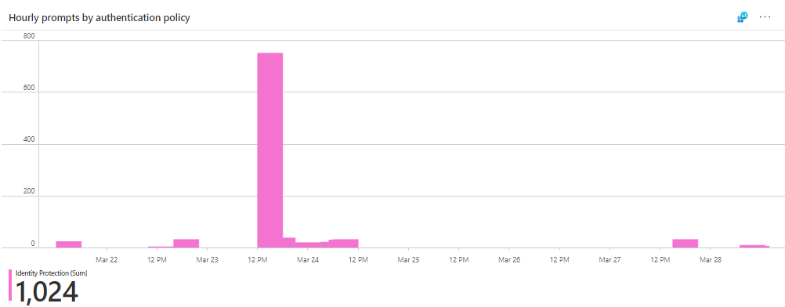
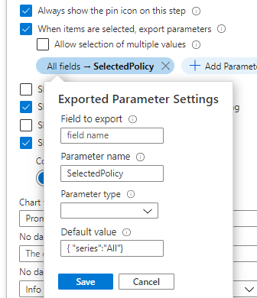
The bar chart is still interactive…
| mv-expand ParsedPolicy = parse_json(tostring('{SelectedPolicy}'))
| extend SelectedPolicy = ParsedPolicy.series
| where SelectedPolicy == 'All' or (AuthPolicy == SelectedPolicy)
Notes:
We still want the pie and bar chart to be interactive, so don’t forget that we have to add the exported parameter settings in the pie chart, and these extra lines to the bar chart query.

Slide 48
Union of two data sets

Slide 49
Recommendations

Slide 50
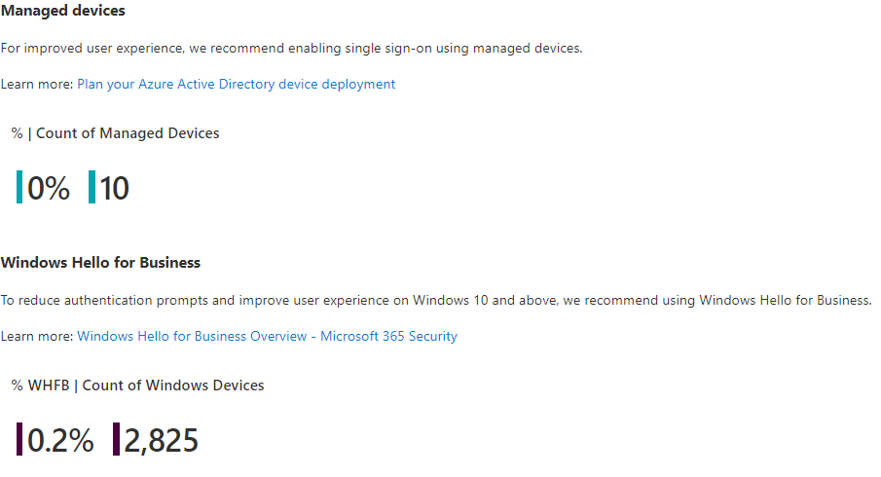
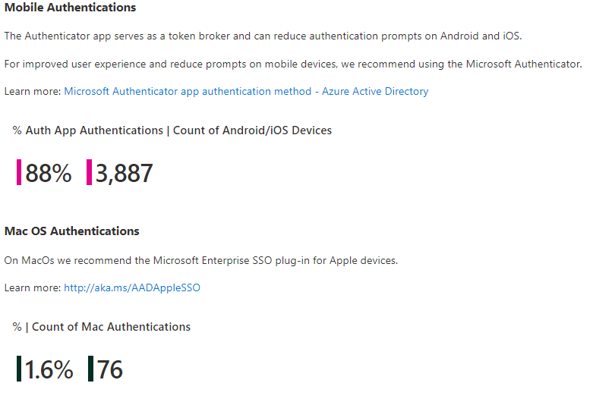
Recommendations

Slide 51
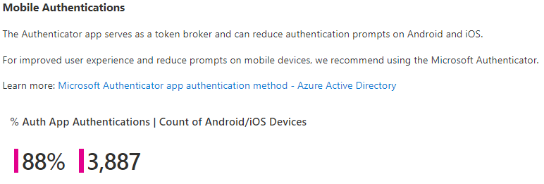
Recommendations: Mobile Authentications

Slide 52
Recommendations: Mobile Authentications
SigninLogs
|mv-expand ParsedFields=parse_json(AuthenticationDetails) //parse out Authentication Details column and put in new column called “ParsedFields”
|extend AuthenticationMethod = ParsedFields.authenticationMethod //create new column by extracting the authenticationMethod value out of the ParsedFields column
|extend AuthMethod = tostring(AuthenticationMethod) //convert to string format
|extend ParsedFields2=parse_json(DeviceDetail) //parse out Device Details column and put in column called “ParsedFields2”
|extend DeviceState = case(DeviceDetail["trustType"] == "", "Unmanaged", DeviceDetail["trustType"]) //convert to string
|extend OperatingSystem = ParsedFields2.operatingSystem //extract the operatingSystem value out of the ParsedFields2 column
|extend OS = tostring(OperatingSystem) //convert to string format
|where AuthMethod != "Previously satisfied" and AuthMethod != "“ //remove Previously Satisfied and blank AuthMethods from the query
|where UserDisplayName != "On-Premises Directory Synchronization Service Account“ //remove this UserDisplayName
|where AuthMethod in ({AuthMethod}) or '*' in ({AuthMethod}) //AuthMethod parameter
|where DeviceState in ({DeviceState}) or '*' in ({DeviceState}) //DeviceState parameter
|where "{User:escape}" == "All users" or UserDisplayName contains "{User:escape}“ //User parameter
|where "{App:escape}" == "All apps" or AppDisplayName contains "{App:escape}“ //App parameter
|where "{OS:escape}" == "All OS" or OS contains "{OS:escape}“ //OS parameter
|extend Status = ParsedFields.succeeded //extract the succeeded valueout of the ParsedFields2 column
|extend AuthStatus = case(Status == "true", "Success", "Failure") //label status as Success or Failure
|where AuthStatus in ({AuthStatus}) or '*' in ({AuthStatus}) //AuthStatus parameter
|extend AuthAppOpp = case(AuthMethod == "Phone call approval (Authentication phone)", "Opportunity", AuthMethod == "Text message", "Opportunity", AuthMethod == "Mobile app notification", "Opportunity","StrongAuth")
|summarize TotalCount = count(), TotalAuthAppOpp = countif(AuthAppOpp != "StrongAuth"), AuthenticatorApp = countif(AuthMethod contains "Mobile app notification")
|project ['% Authenticator App Sign-Ins'] = (1.0 * AuthenticatorApp/TotalAuthAppOpp), TotalCount

Slide 53
Our ask to the MVP Community…

Slide 54
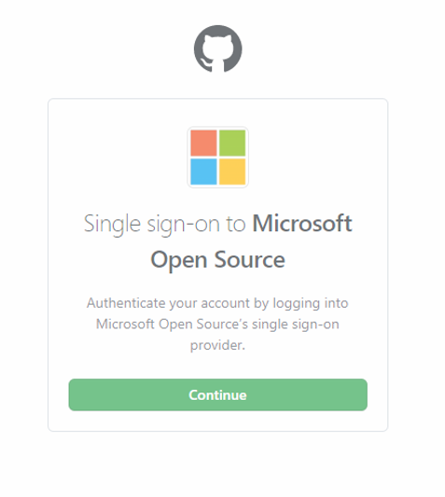
We want you to contribute!
Join the Azure AD Workbooks community on GitHub​
Think about the questions you have heard from your customers/partners/associates repeatedly. Could a workbook help address this?​
Help others improve their workbooks​
Create and submit your own workbooks​
All resources shared in the presentation can be found at aka.ms/KQLMVP

Slide 55
Resources (aka.ms/KQLMVP)
Azure Monitor Workbooks Overview​ – great starting place when learning about workbooks
Configure a Log Analytics Workspace – if you don’t already have a LA workspace, use this tutorial to set one up
How to use Azure AD workbooks ​ - a brief write-up about most of the workbooks in the gallery
Microsoft Organization in GitHub and @azure-ad-workbooks ​– join this GitHub Repo and team to learn much more about Azure AD Workbooks as well as to contribute.
Kusto Query Language (KQL) from Scratch​ – great Pluralsight Tutorial for learning KQL
aka.ms/PreviewWorkbooks ​– see Azure AD Workbooks in private preview!
All resources shared in the presentation can be found at aka.ms/KQLMVP

Slide 56
Questions and (hopefully) Answers

Slide 57

We value your feedback
Please complete the short session survey
Stay in touch:
Corissa Koopmans | @Corissalea
Tosin Lufadeju | @TosinLuf_PM
All resources shared in the presentation can be found at aka.ms/KQLMVP

Slide 58
Thank You!

Slide 59
Appendix

Slide 60
